Slide 1


DEPARTMENT OF COMPUTER SCIENCE AND ENGINEERING
INTERDISCIPLINARY PROJECT - II
IOT BASED PORTABLE TRACKING DEVICE
PROJECT STUDENT GUIDE
Kavirithanya E V, 42110613 Dr. S. Prayla Shyry, M.E.,Ph.D., Professor, CSE

Slide 2
AGENDA
Certificate
Introduction
Abstract
Objective
Literature Survey
System Architecture / Ideation Map
Module Implementation
Results and Discussions
Conclusion
References

Slide 3
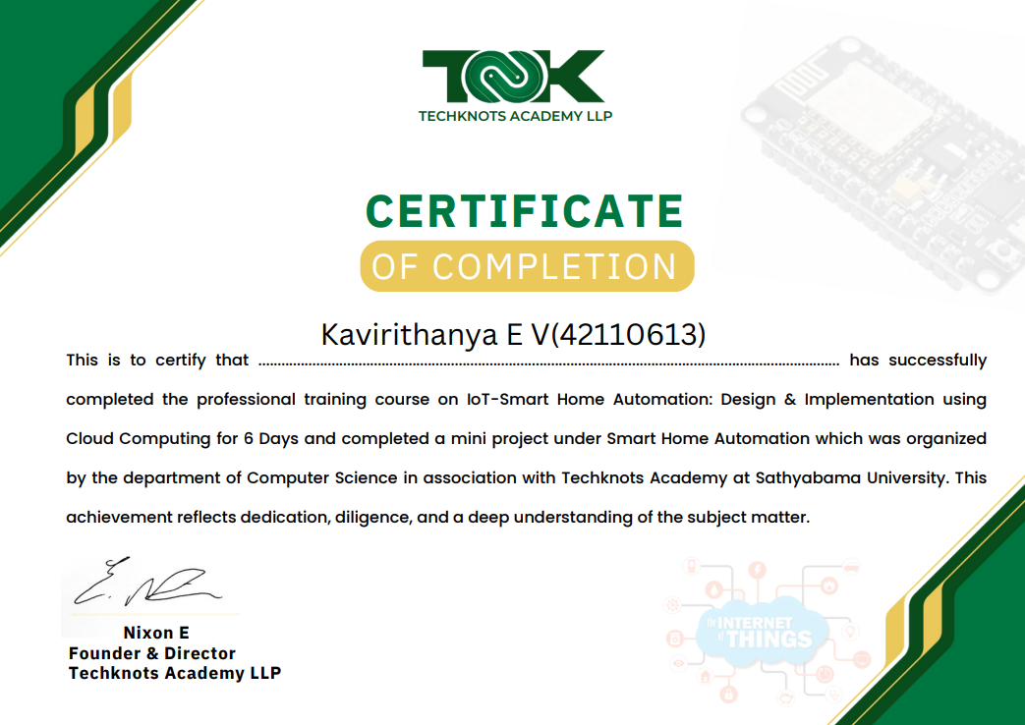
COURSE CERTIFICATE

Slide 4
INTRODUCTION
In today’s fast-moving world, real-time tracking of personal belongings, vehicles, and loved ones has become a necessity.
This project presents a cost-effective, portable tracking device powered by GPS and IoT technologies, offering accurate, real-time location data without depending on Bluetooth or limited-range systems.
Using components like the Neo-6M GPS module and NodeMCU ESP8266, the device connects via Wi-Fi to a web or mobile interface, making it ideal for tracking luggage, vehicles, children, or the elderly.
With a built-in manual Piezo buzzer for local alerts, it provides a reliable alternative to commercial trackers like Apple AirTag, especially in low-connectivity areas.

Slide 5
ABSTRACT
This project introduces an affordable, portable tracking device that utilizes GPS and IoT technologies to offer real-time location tracking without relying on Bluetooth or limited-range ecosystems. Built using widely accessible components like the Neo-6M GPS module and NodeMCU ESP8266 microcontroller, this compact device provides accurate geolocation data that can be transmitted to a web or mobile interface through Wi-Fi. Designed for use with luggage, vehicles, or vulnerable individuals such as children or elderly people, this solution includes a manually activated piezo buzzer for easy nearby item location. It serves as a reliable and cost-effective alternative to commercial trackers like Apple AirTag especially in areas with poor Bluetooth or cellular connectivity.

Slide 6
OBJECTIVE
Develop a portable and low-cost tracking device using GPS and IoT technologies.
Enable real-time location tracking via a web or mobile interface using Wi-Fi.
Ensure compatibility for various use cases such as luggage, vehicles, children, and elderly tracking.
Integrate a manual piezo buzzer to help users easily locate items nearby.
Utilize widely available and affordable components for easy assembly and maintenance.

Slide 7
LITERATURE SURVEY
R. Ramya, B. Palaniappan, K. Karthick (2013) | In their paper “Embedded Controller for Vehicle In-Front Obstacle Detection and Cabin Safety Alert System”, the authors explored GPS-GSM-based tracking systems for vehicles. Though accurate, these systems depend on GSM connectivity, which limits their application in rural areas.
M.A.Mazidi, S.N.Patel (2016) R. Patel, R. Agrawal (2018) | Their system used GSM modules to send real-time GPS coordinates via SMS, which is useful but increases cost and power usage. Researchers have employed the ESP8266 to create low-cost, Wi-Fi-enabled tracking systems that publish data to cloud dashboards, offering real-time tracking solutions for vehicles.

Slide 8
LITERATURE SURVEY
S. Patel, R. Mehta (2018) S. R. Jadhav, P. A. Patil (2019) | The authors designed an IoT-enabled tracking device using NodeMCU and GPS modules, highlighting the efficiency of Wi-Fi-based location monitoring and cloud data integration. This study presents a GPS tracking system integrated with a web-based interface for real-time vehicle monitoring. The system captures GPS data using a GPS module and transmits it via Wi-Fi to a web server
A. Sharma , P. Varma (2020) | This study analyzed commercial products like Apple AirTag and Tile, pointing out limitations due to Bluetooth range and dependency on dense device ecosystems.

Slide 9
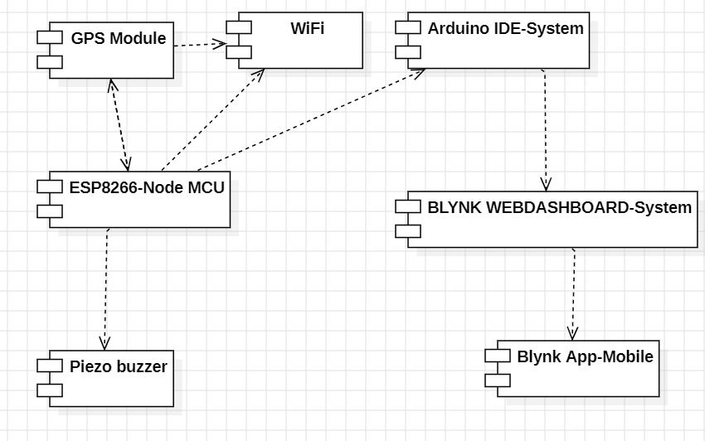
SYSTEM ARCHITECTURE

Slide 10
MODULE IMPLEMENTATION
HARDWARE REQUIREMENTS:
1) Neo6M GPS Module
Function: Provides real-time location (latitude, longitude, altitude).
Interface: UART (Serial communication with ESP8266).
Power: Typically 3.3V–5V.
Output: NMEA sentences (parsed using TinyGPS++ library).
2) Node MCU ESP8266
Function: Wi-Fi-enabled microcontroller for wireless data transmission.
Connects to Wi-Fi (station mode) or acts as an access point
Can send data to cloud (HTTP/MQTT) or a local server.
Power: 3.3V (built-in regulator on NodeMCU).

Slide 11
MODULE IMPLEMENTATION
3) Piezo Buzzer:
Function: Audible alerts
Power: 3.3V–5V
4) Power Supply:
USB power (5V) – ESP8266
LiPo battery (3.7V) or Power bank for portability.
5) Supporting Components:
Jumper Wires – Prototyping connections.
Antenna – To acquire GPS signal.

Slide 12
MODULE IMPLEMENTATION
SOFTWARE REQUIREMENTS:
1) Arduino IDE:
Purpose: Write and upload firmware to ESP8266.
Required Add-ons: ESP8266 board package (via Board Manager).
Serial Monitor: Checks GPS data, Wi-Fi status, and errors.
2) GPS Library (TinyGPS++):
Function: Parses NMEA data into readable coordinates.
3) Wi-Fi & Cloud Libraries:
ESP8266WiFi.h: Manages Wi-Fi connections.
HTTPClient/MQTT: Sends data to web servers/IoT platforms.
4) Buzzer Control:
Method: tone(pin, frequency) for basic beeps.

Slide 13

RESULTS AND DISCUSSIONS
1.Frontend of buzzNfind:

Slide 14
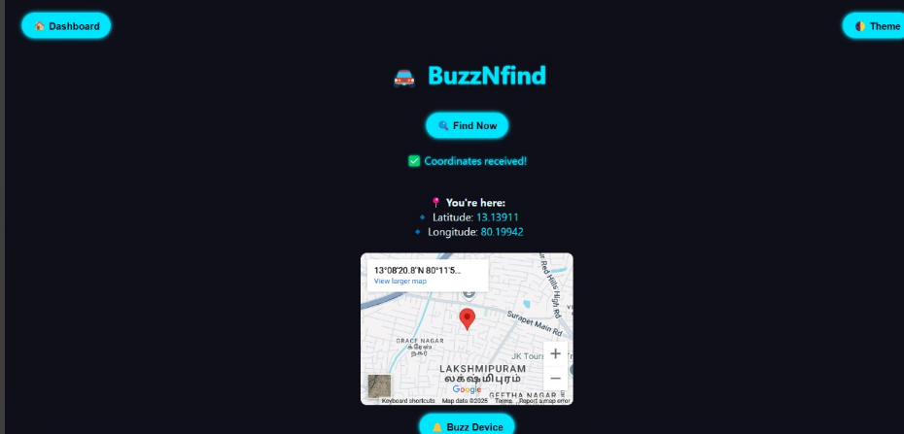
RESULTS AND DISCUSSIONS
2.Current latitude and longitude mapped:

Slide 15
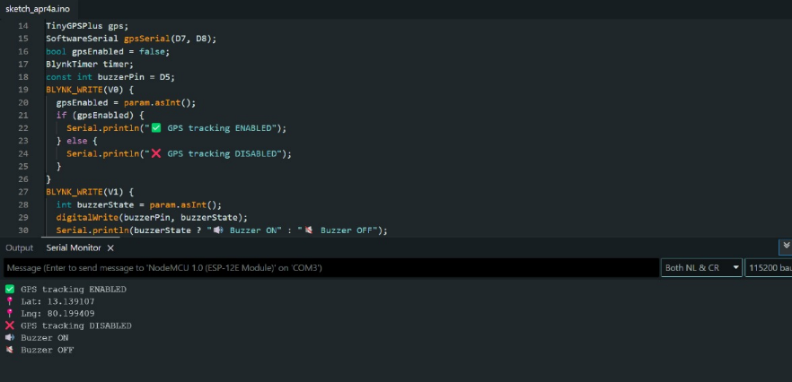
RESULTS AND DISCUSSIONS
3.Output from GPS Tracking:

Slide 16
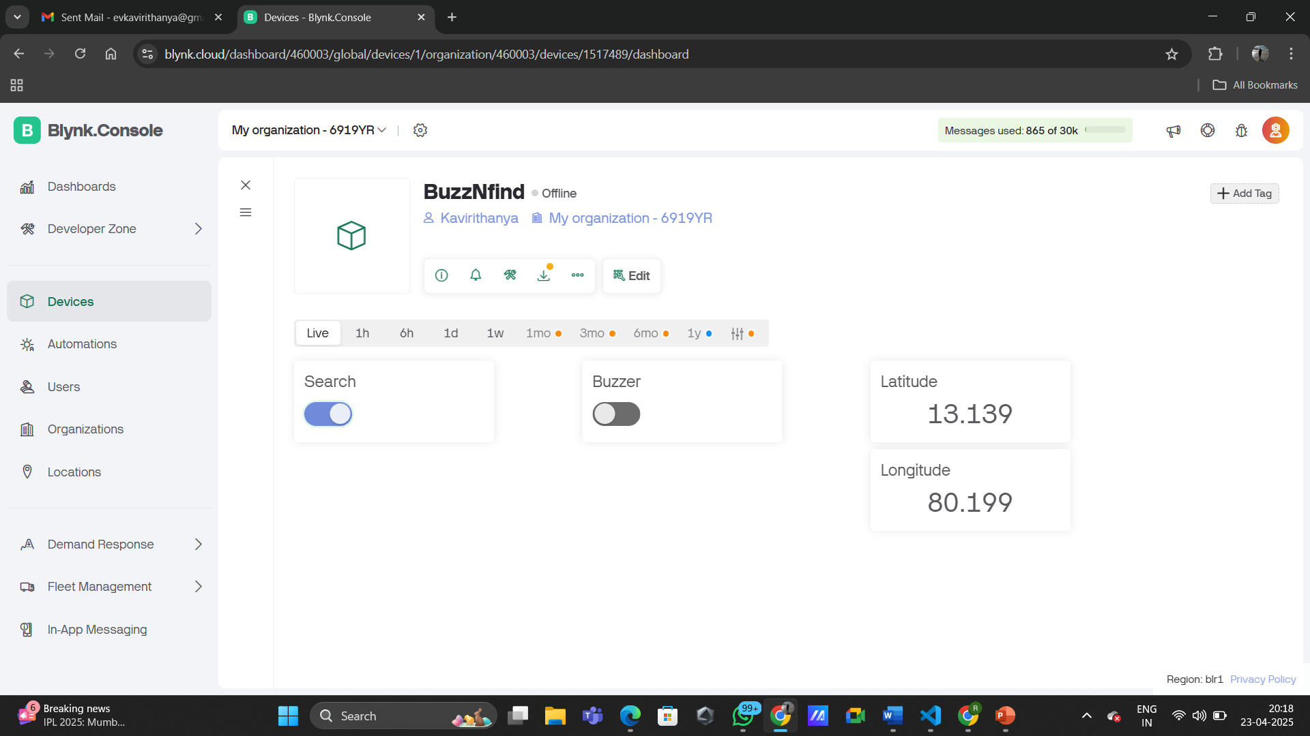
RESULTS AND DISCUSSIONS
4. Blynk web dashboard and mobile app

Slide 17
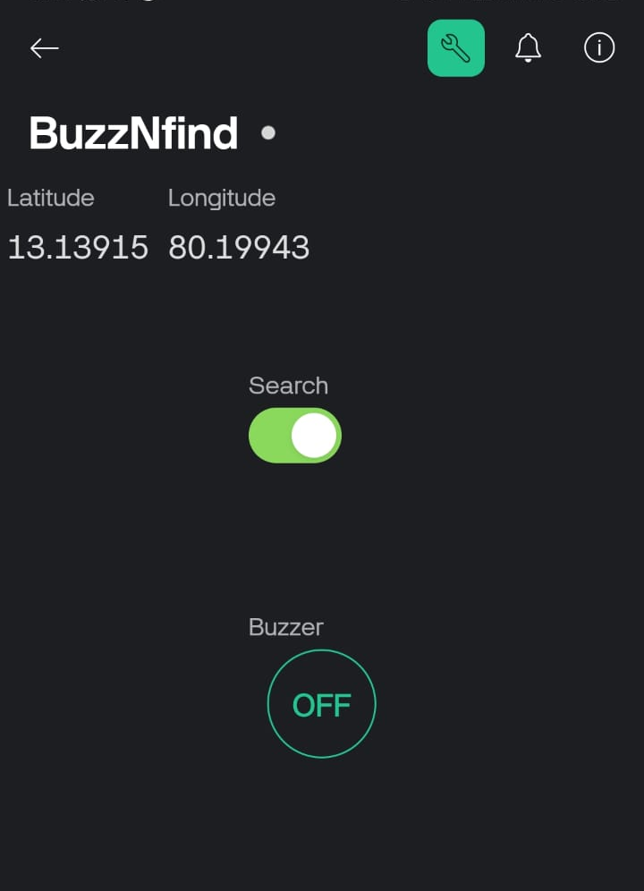
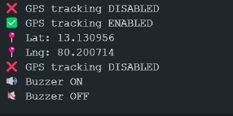
RESULTS AND DISCUSSIONS
6.Serial Monitor Output:
5.Blynk mobile app

Slide 18
RESULTS AND DISCUSSIONS
Prototype:
Successfully integrates GPS, NodeMCU & buzzer; accurately tracks location and responds to virtual pin (V1) triggers.
Blynk Web Dashboard:
Displays real-time coordinates; allows remote buzzer activation through a simple, intuitive interface.
Frontend Web App:
Custom-built site fetches live GPS data via Blynk API; visualizes location on embedded Google Map; includes buzzer control
Serial Monitor:
Logs GPS data, confirms GPS fix and Wi-Fi status; displays buzzer ON/OFF status and debugging info.

Slide 19
CONCLUSION
This project presents a DIY, low-cost GPS-based IoT tracker using an ESP8266, GPS module, and buzzer. Unlike commercial trackers like Apple AirTag that rely on Bluetooth, BuzzNfind offers customizable, real-time location tracking over Wi-Fi and cloud. The added buzzer enhances usability by enabling audible alerts for easier item retrieval. With features like offline GPS, scalability, and the option for future upgrades like deep sleep for battery efficiency or LoRa for extended coverage, it stands as a reliable and accessible alternative to proprietary solutions. Perfect for tracking luggage, vehicles, pets, or personal belongings. This device proves the power of open-source innovation in practical IoT applications.

Slide 20
REFERENCES
[1] Adafruit, Piezo Buzzer – Basic. Adafruit Industries, 2020. [Online]. Available: https://www.adafruit.com/product/160
[2] Arduino, TinyGPS++ Library Documentation. Arduino Project Hub, 2021. [Online]. Available: https://github.com/mikalhart/TinyGPSPlus
[3] Blynk, Blynk HTTP RESTful API Documentation. Blynk, 2022. [Online]. Available: https://docs.blynk.io/en/blynk.cloud/http-restful-api
[4] Blynk, Getting Started with Blynk. Blynk, 2021. [Online]. Available: https://docs.blynk.io/en/getting-started/
[5] Espressif Systems, Getting Started with ESP8266 on Arduino IDE. Espressif, 2021. [Online]. Available: https://docs.espressif.com/projects/arduino-esp8266/en/latest/
[6] G. C. Martins et al., “Energy-Efficient Low-Power Circuit Techniques for Wireless Energy and Data Transfer in IoT Sensor Nodes,” arXiv preprint, arXiv:1704.08910, 2017.
[7] H. Okuhara et al., “An Energy-Efficient Low-Voltage Swing Transceiver for mW-Range IoT End-Nodes,” arXiv preprint, arXiv:2010.04566, 2020.

Slide 21
REFERENCES
[8] L. Zhao, “Battery Power Optimization Techniques for IoT Systems,” IEEE Transactions on Industrial Informatics, vol. 15, no. 5, pp. 3244–3251, May 2019, doi: 10.1109/TII.2018.2879293
[9] M. Mohan et al., “Design and Implementation of Real Time Vehicle Tracking System Using GPS and GSM,” International Journal of Engineering Research & Technology, vol. 9, no. 6, pp. 120–123, Jun. 2020
[10] R. C. Lee et al., “Low Power Design for Internet of Things Devices,” IEEE Internet of Things Journal, vol. 7, no. 1, pp. 35–45, Jan. 2020, doi: 10.1109/JIOT.2019.2932555
[11] SparkFun Electronics, Piezo Buzzer Hookup Guide. SparkFun, 2020. [Online].
[12] Ublox, NEO-6M GPS Module User Manual. Ublox, 2020. [Online].
[13] W. Wang et al., “Enabling Low-Power OFDM for IoT by Exploiting Asymmetric Clock Rates,” arXiv preprint, arXiv:2002.07155, 2020. [Online]. Available: https://arxiv.org/abs/2002.07155
[14] Y. Sharma et al., “IoT-Based Smart Luggage Tracker Using GPS and GSM,” in Proc. of the 2021 International Conference on Communication and Electronics Systems (ICCES), pp. 135–140, 2021, doi: 10.1109/ICCES51350.2021.9489149

Slide 22
THANK YOU
We thank our Department, Guide, Panel Members, Supportive Professors and all Technical and Non-Technical staff who helped us in our Project.

